Slide 1
SEO for E-commerce Websites
Owen Gill

Slide 2
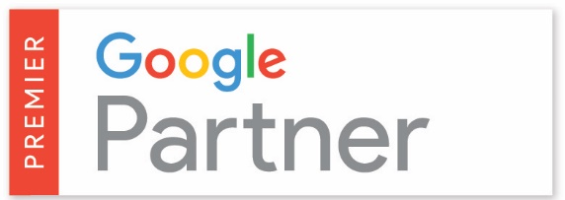
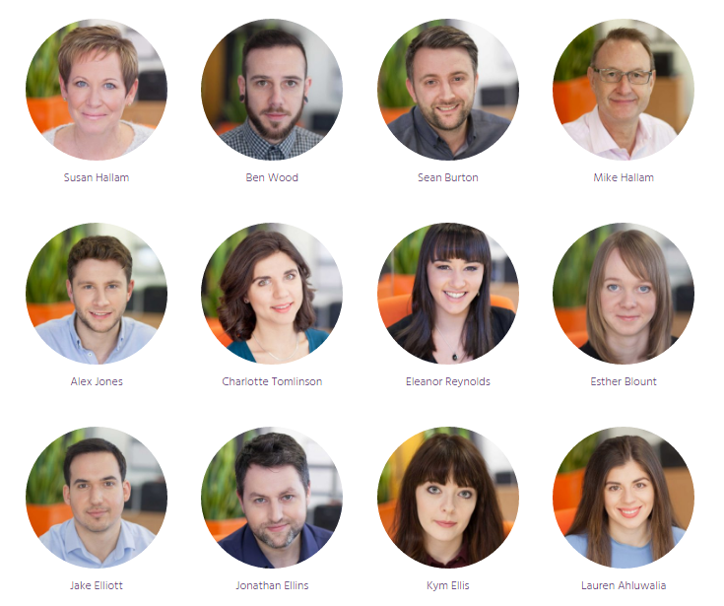
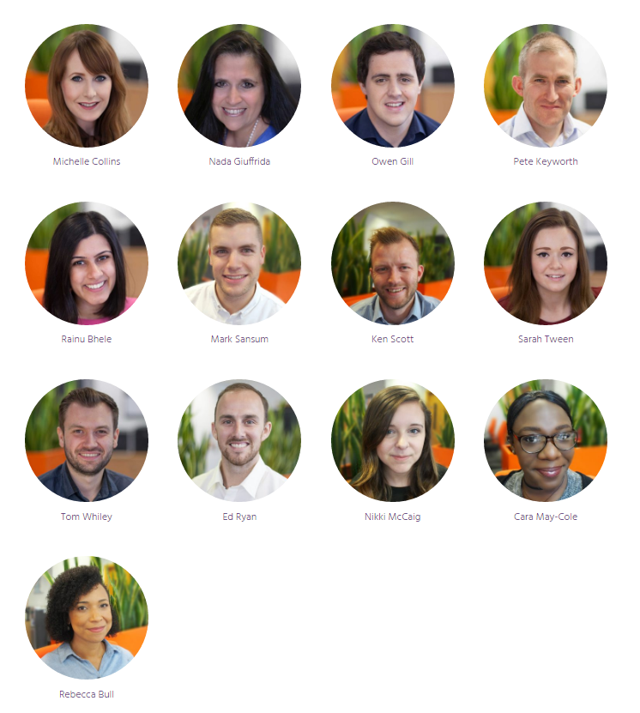
Hallam Internet
Some of the amazing companies we work with:
Our services:
Search Engine Optimisation (SEO)
Paid Search (PPC)
Digital PR
Social Media
Digital Strategy
Email Marketing
Training

Slide 3
Key Points
Changes in SERPs until 2016 and future developments
How mobile usage is changing and how it’s affecting the user buying cycle
Importance of content for e-commerce sites and generating prominent SERP visibility

Slide 4
Changes to SERPs What we’ve seen and what we’re expecting

Slide 5
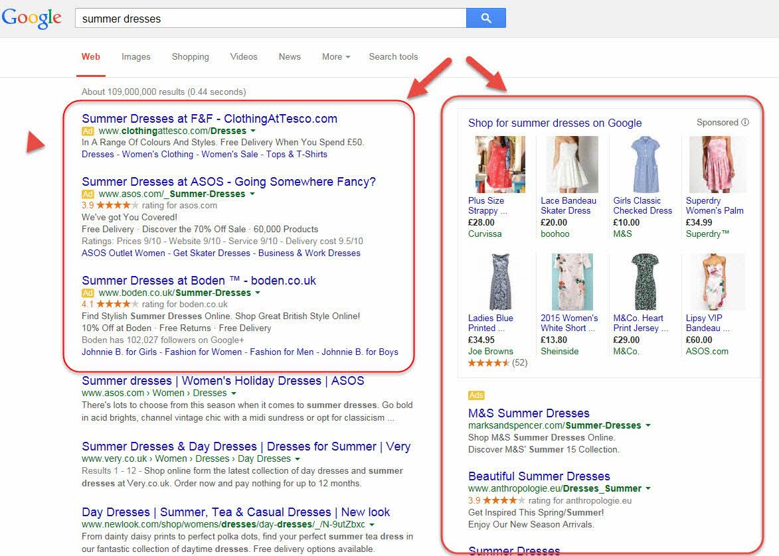
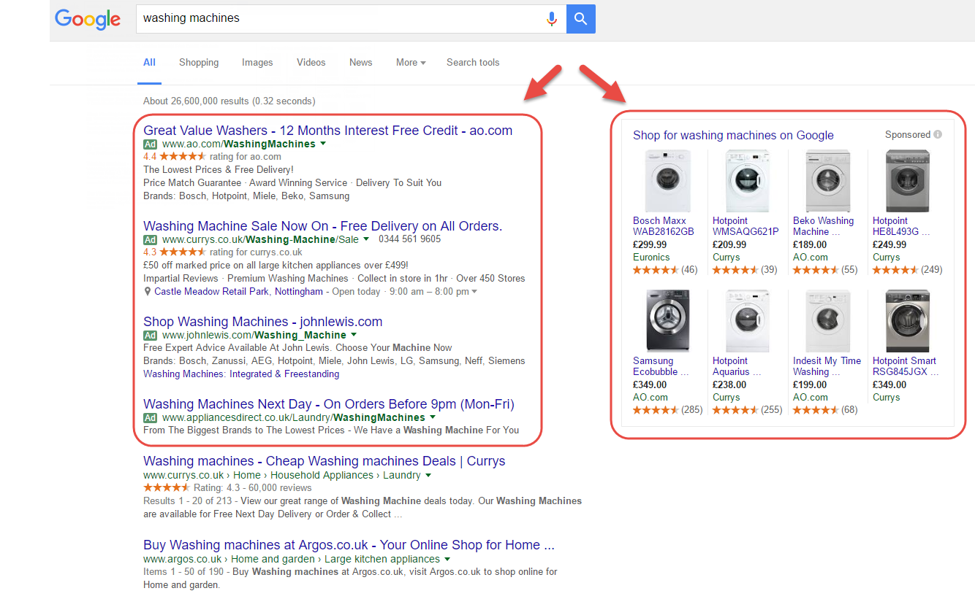
Changes to SERPs – Past 18 Months
Ad relocation
Ad tab colour changes
Extended ad format
Increasing ad extensions
Organic result extensions

Slide 6
Changes to Mobile SERPs
Smaller number of organic results (Search Metrics Study 2016)
8.5 = average number of organic results on mobile
8.6 = average number of organic results on tablet
First mobile organic result has fall down the SERP
Additional information being shown in SERPs
Social media, local information, knowledge graphs…
Accelerated mobile pages (AMP) one year on
Oct 2016 @ SMX East, Google celebrated AMP success and that it will be continued focus
Now part of Google’s core algorithm

Slide 7
Growth in Mobile Usage
In 2014, for the first time there were more mobile search sessions than on desktop
Q4 2014: Mobile conversion rate = 1.94% (UK)
Q4 2015: Mobile conversion rate = 3.05% (UK) (monetate.com)
September 2015: Mobile share of e-commerce orders = 26%
September 2016: Mobile share of e-commerce orders = 29% (custora.com)

Slide 8
Affects of SERP Changes
Increased PPC activity has lead to more competitive auctions and a rise in advertising costs. This makes the option to go ‘paid’ for many businesses a considerable expense
User engagement rates with organic results have decreased according to studies by Search Metrics and MOZ
Branded3 Case Study:
CTR for position 1 in April 2016 = 31%
CTR for position 1 in September 2016 = 24%

Slide 9
What Will 2017 SERPs Look Like?
Adverts occupying more premium retail space on SERPs making it harder for organic results to gain ‘human’ visibility
Google has been testing larger meta descriptions for organic results
With extended adverts having already been rolled out, this is putting the ‘squeeze’ on organic results
Additional information is getting added to organic results – we expect this to continue
Will we be able to tell the difference between an advert and an organic result at first glance?
In 2016, there were 8.5 organic results on average on a mobile and 8.6 on a tablet. With the above points, this number could yet reduce further

Slide 10
Buying Behaviour Affecting the User Journey

Slide 11
How User Buying Behaviour is Evolving
Users are lazy! Or are they just being picky with what information they consume?
The research process is getting more thorough because of the quality information available
Device advances are making all parts of the buying cycle easy
Source : marketingland.com

Slide 12
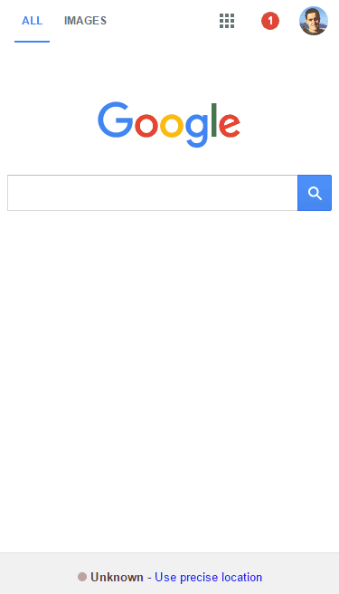
Importance of Soft Content
Difficult to gain visibility for high volume, short-tail terms
Target long-tail, lower volume terms
Lower competition with high relevance
User buying processes are becoming increasingly complex with more touchpoint opportunities
Catch the users at the beginning of the buying cycle

Slide 13
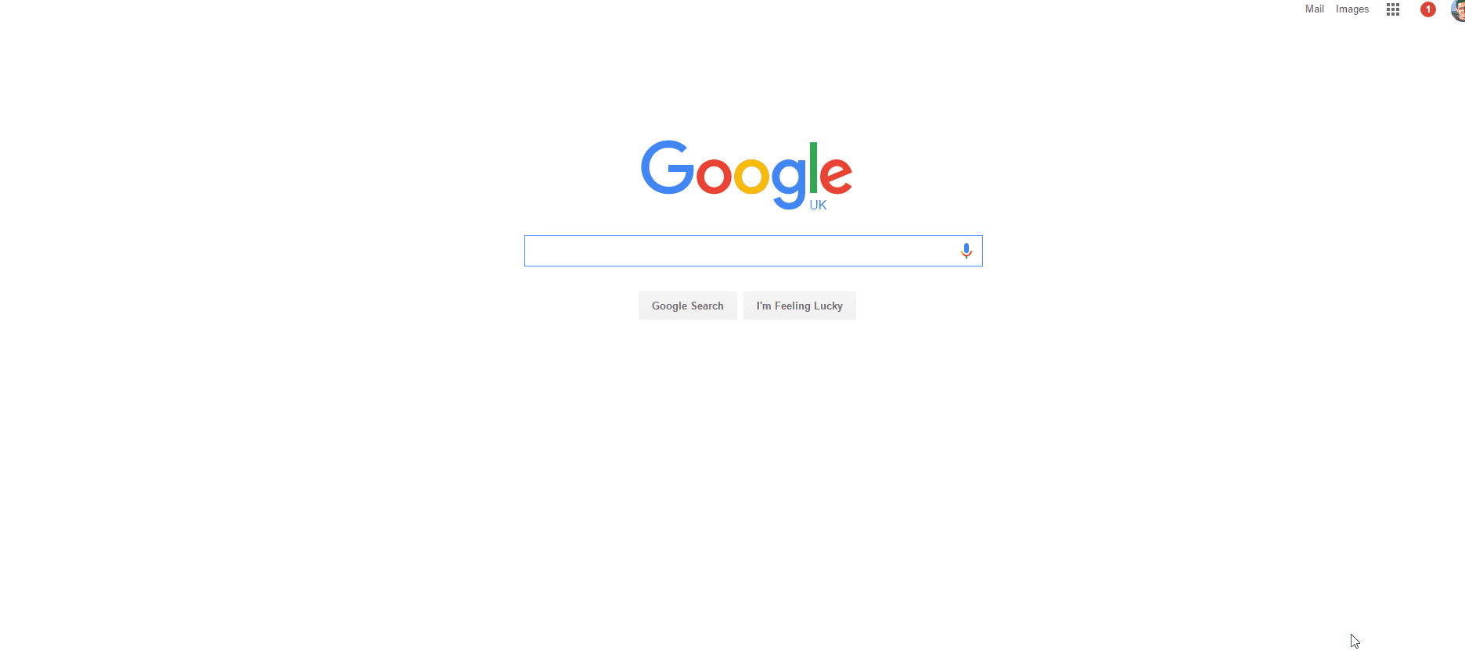
Product Content
Recommendation: Use of Schema Markup
Provide search engines with relevant information about the product/service

Slide 14
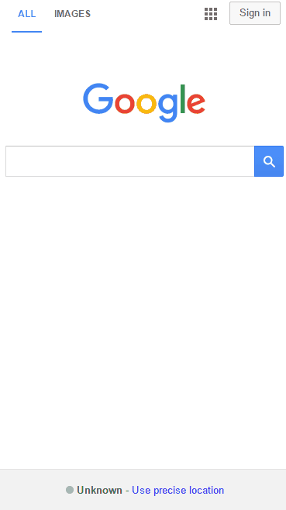
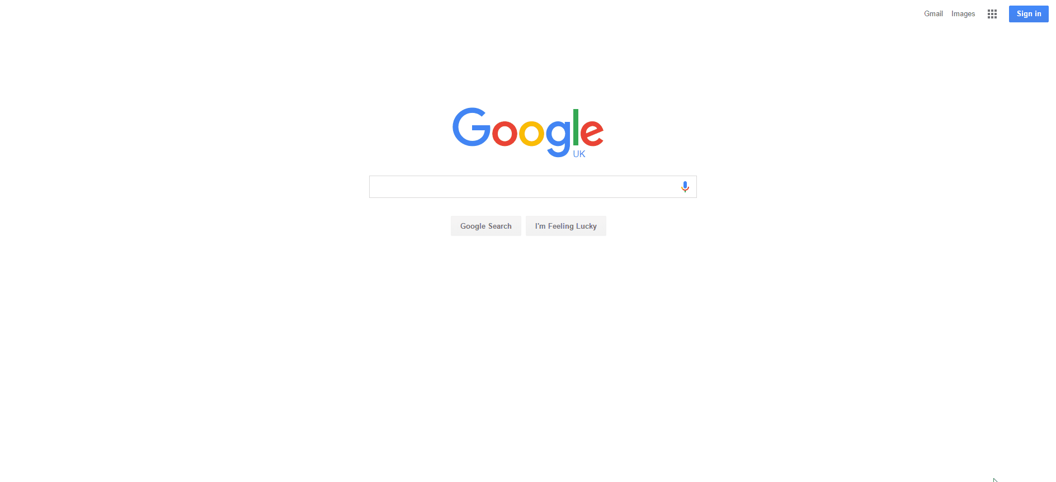
How To Maximise Visibility in 2017
Google has been and will continue to show more varied information to the user that relates to their search. Ensure your off-site information is up-to-date and optimised.
Third-party sites (aggregators) gain strong visibility for high volume search terms in competitive industries – consider their potential value.
The user journey is getting more complex as more information gets presented to them. Utilise content tactics to ensure you’re taking advantage of every touch point.

Slide 15
Retention is the Key to Success
Never has it been more important to get visitors to return to your website
Competitiveness to acquire organic visitors has increased
Cost of acquiring paid visitors has risen
Identify problem pages and sections on your website
Poor load speed
Low user engagement
The importance of user behaviour as a ranking factor is increasing
Google wants you to create content for ‘humans’ not ‘robots’
Continuing emphasis on mobile with AMPs highlights this

Slide 16
Summary
We anticipate a further ‘squeeze’ on organic results in SERPs
Additional information to continue to populate the SERPs
All offsite information needs to be up-to-date. Visibility for this type of content is increasing
Influencing the user journey earlier
Competition for P1/P2 organic listing is getting harder and engagement is reducing
Create soft content with a purpose to engage with potential customers earlier in the buying cycle
Those who weren’t ready for mobile 3 years ago, must be ready by 2017!
Customers consume product information like they do news, they expect it to be easily obtained and clearly displayed
Ensure all content is compatible with a mobile device
Retention of users is increasing in its importance
Acquisition is getting harder for standard organic results, therefore user retention is key
Identify problem pages and content that result in negative user behaviour

Slide 17
Thank you for you time!

