Slide 1
ChatGPT & Current Uses
Zak Averre

Slide 2
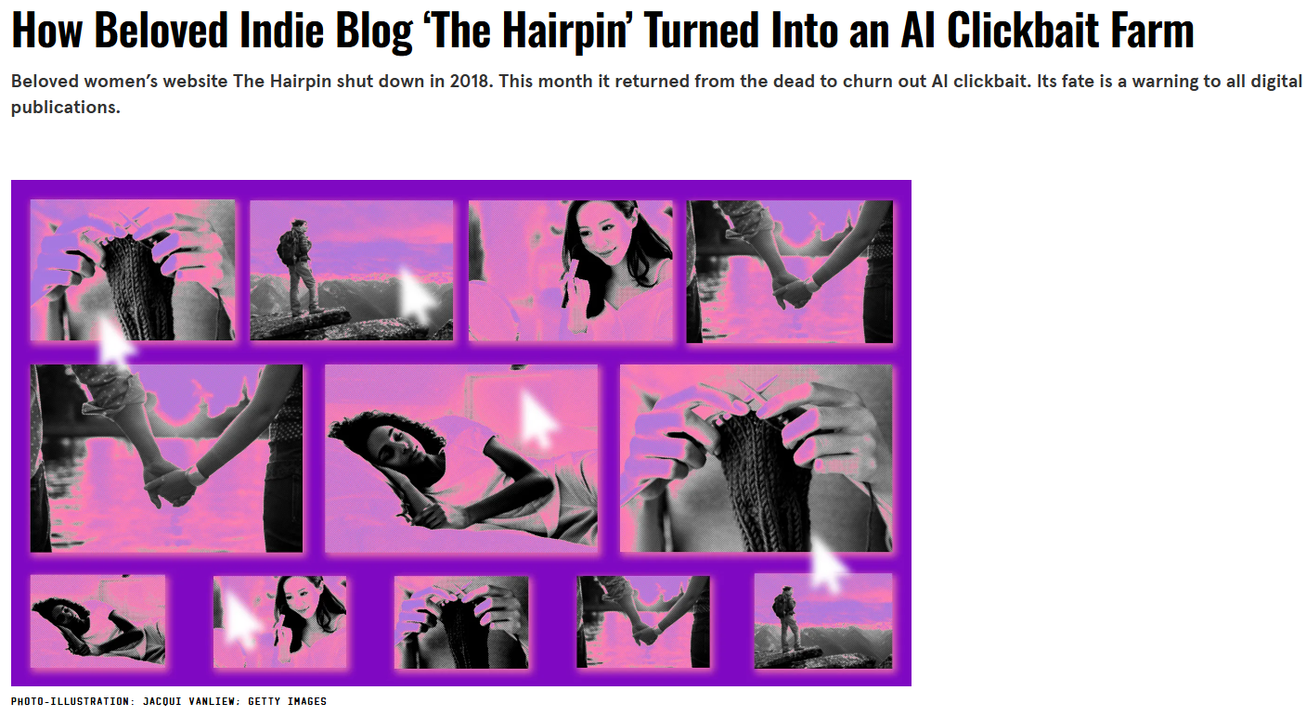
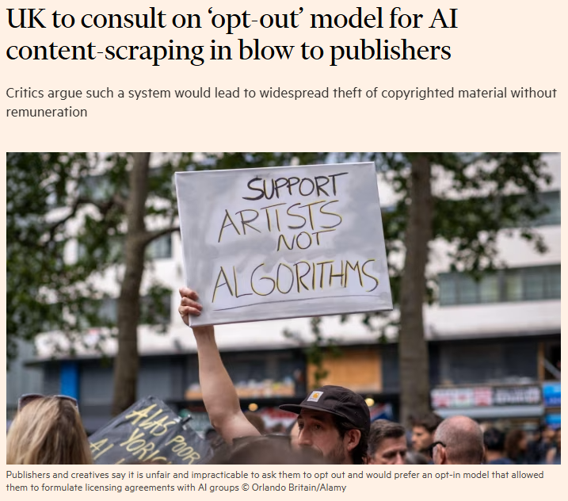
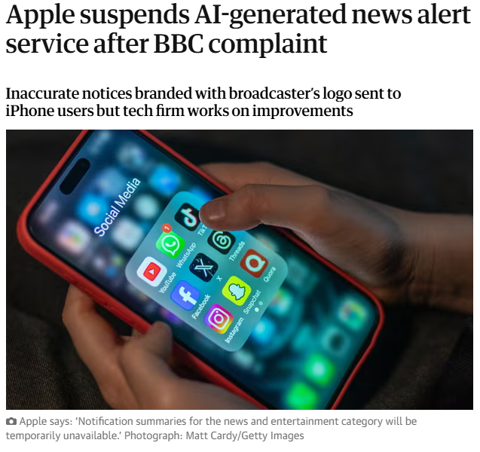
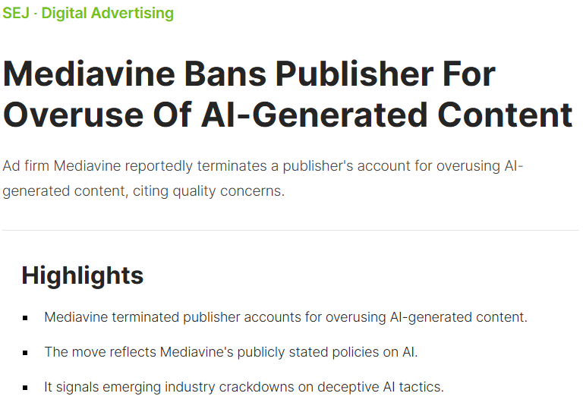
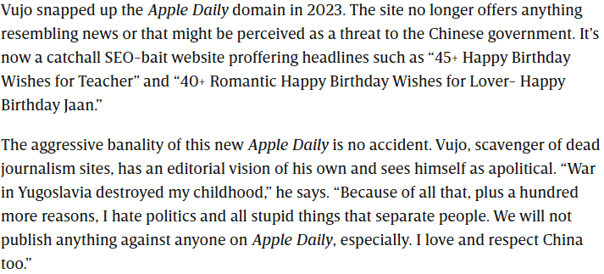
Where is AI today?
AI perceptions
Well, it’s complex…

Slide 3
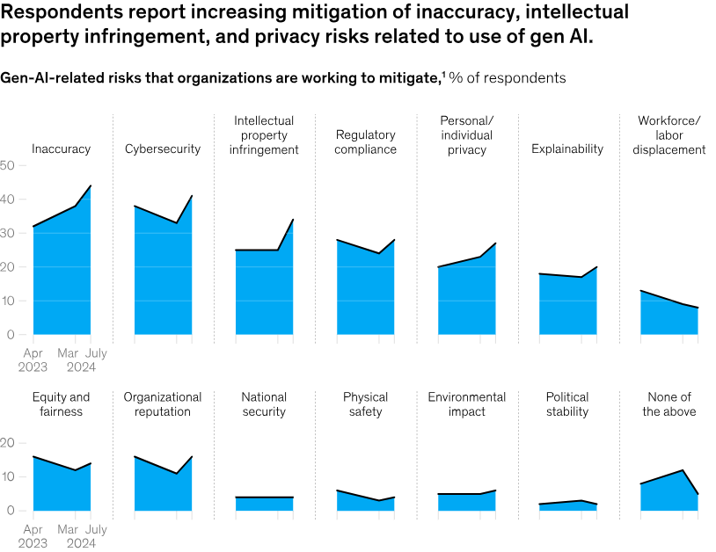
Where is AI today?
AI Perceptions
AI is a powerful tool but is still in development. This means there is a lack of defined borders to how it works.
This has placed question marks over the technology somewhat as people look to justify its use but in a ‘responsible way’.
Plus: generative AI responses are beige.

Slide 4
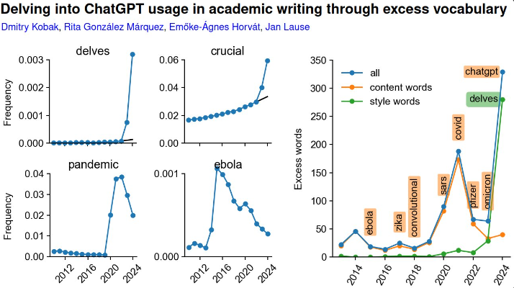
Where is AI today?
AI Perceptions
Case in point, the most overused ChatGPT words include:
Delve, tapestry, vibrant, landscape, realm, embark, excels, vital, comprehensive, moreover, arguably, notably.

Slide 5

Where is AI today?
AI perceptions
Most overused ChatGPT phrases:
Dive into
It’s important to note
It’s important to remember
Important to consider
Based on the information provided
Remember that
Navigating the landscape
Delving in the intricacies of

Slide 6

What can you do?

Slide 7

How to use ChatGPT
How to use AI effectively
Use AI for research and collating data/information
Use AI to create a starting point for creative tasks
Use AI to think outside the box
Use AI to understand what competitors are doing better than you

Slide 8
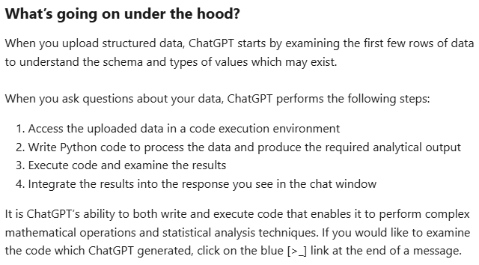
How to use ChatGPT
How to use AI effectively
When it comes to data and information collation, that’s where AI shines.
Logical tasks reliant on parsing data and presenting it in helpful ways.
This can be FOI data requests, turning figures into charts, the list goes on.

Slide 9
What can you do?

Slide 10

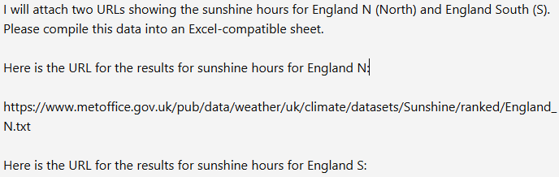
How to use ChatGPT
Example: Sunlight hours
Collect and analyse sunlight hours for a feature.
We have the raw data from the Met Office but this is not in a workable format.
We split into regions and provide the data.

Slide 11
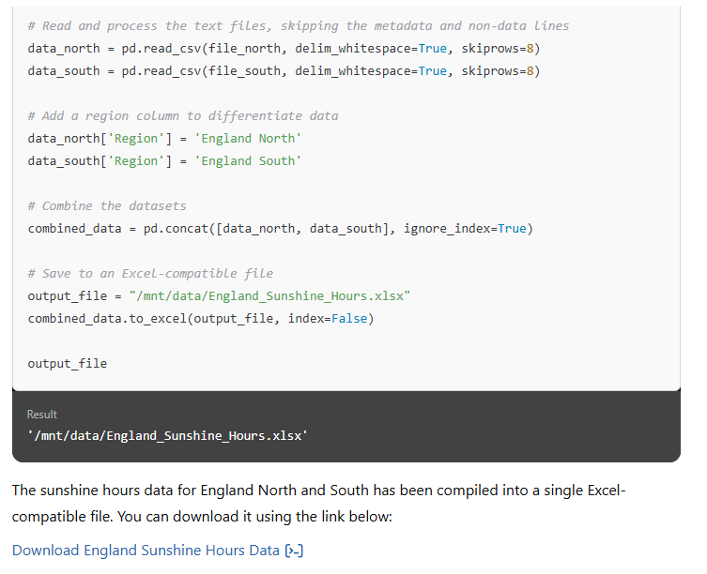
How to use ChatGPT
Example: Sunlight hours
This required a download of a .txt file to allow ChatGPT to parse the data.
The first result was a mess.
It combined North and South, didn’t order by date.

Slide 12


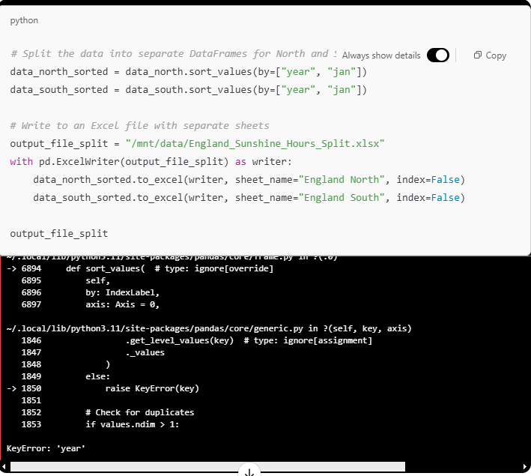
How to use ChatGPT
Example: Sunlight hours
With a little tweaking and direction, however, I was able to turn the wall of numbers into something that can be used for articles, infographics, PR outreach pieces etc.

Slide 13
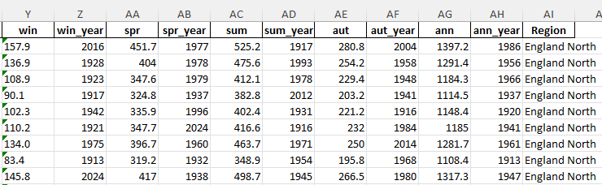
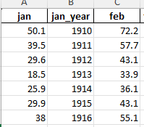
How to use ChatGPT
Example: Sunlight hours

Slide 14
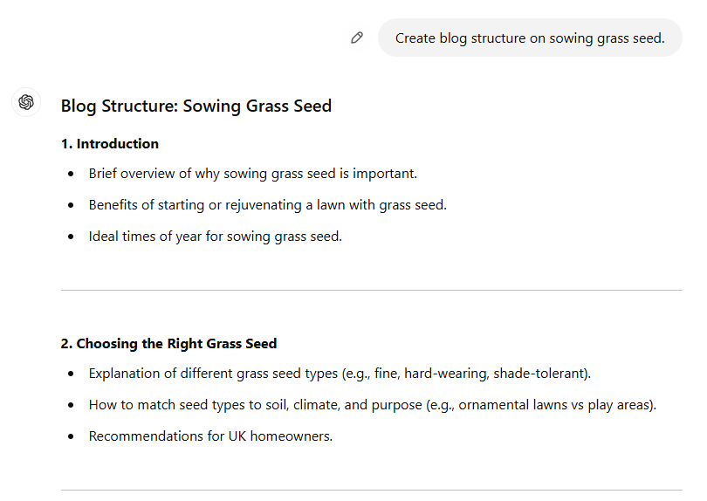
How to use ChatGPT
Example: Creative support
For creative tasks, work with the data you want. Feed AI the sources. Please don’t assume it knows what information is best.
Don’t be vague, provide detail, direction, and examples like this.
If possible, save prompts that include your brand voice and direction for future use.

Slide 15
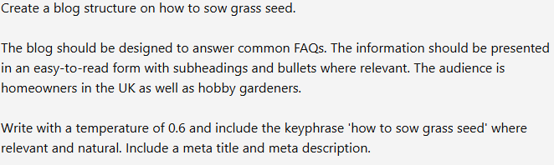
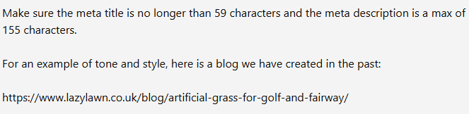
How to use ChatGPT
Example: Creative support
In this example you can see how we provide extra information.
Target audience
Temperature for style
Requirements like metadata
Example piece for TOV reference

Slide 16
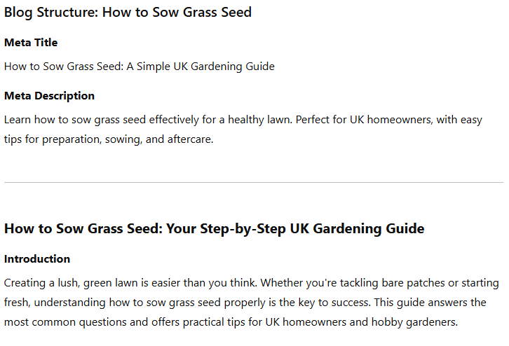
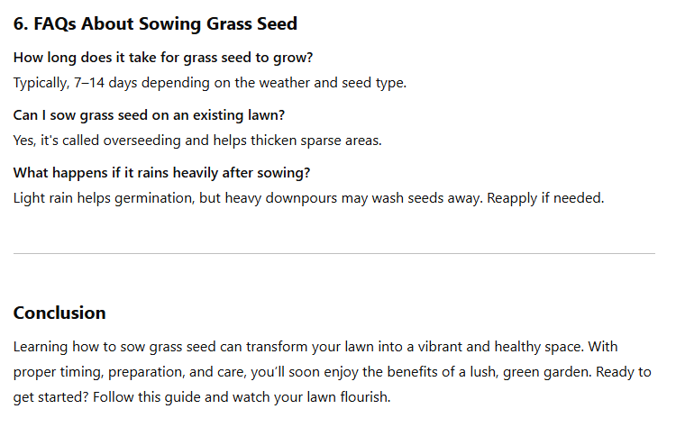
How to use ChatGPT
Example: Creative support
Providing more data, detail, and instructions will allow you to craft better responses and speed up delivery.

Slide 17
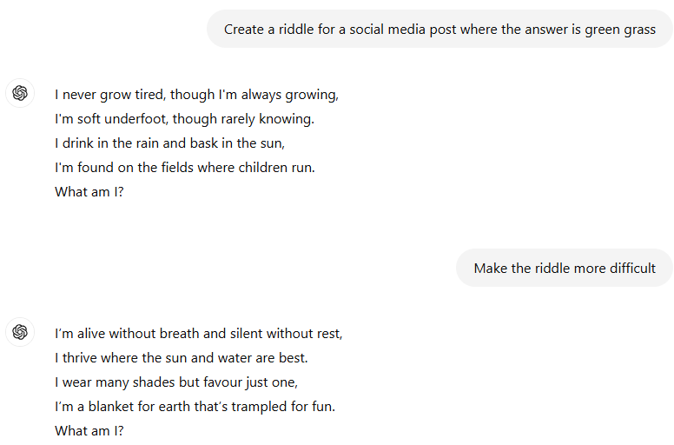
How to use ChatGPT
How to use AI effectively
Thinking outside of the box is particularly useful for social campaigns.
Consider unique short form content like riddles, jokes, or short narratives.
This allows users who don’t enjoy creative exercises to come up with ideas and content for social calendars.

Slide 18
How to use ChatGPT
How to use AI effectively
Thinking outside of the box is particularly useful for social campaigns.
Consider unique short form content like riddles, jokes, or short narratives.
This allows users who don’t enjoy creative exercises to come up with ideas and content for social calendars.

Slide 19
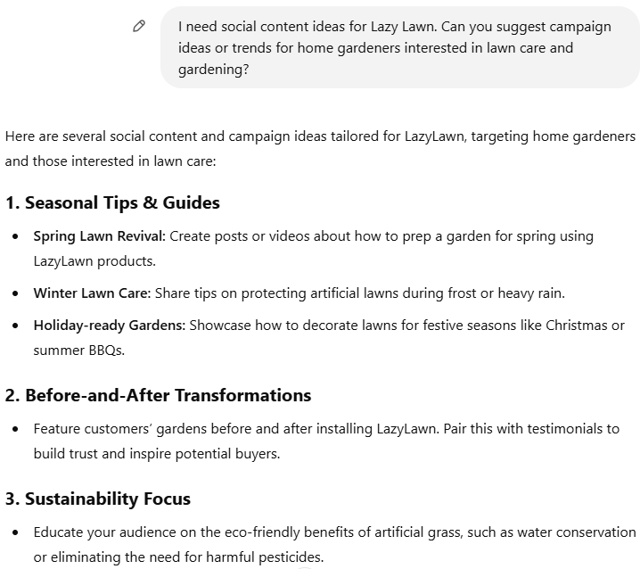
How to use ChatGPT
How to use AI effectively
Thinking outside of the box is particularly useful for social campaigns.
Consider unique short form content like riddles, jokes, or short narratives.
This allows users who don’t enjoy creative exercises to come up with ideas and content for social calendars.

Slide 20
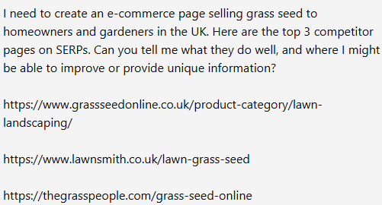
How to use ChatGPT
How to use AI effectively
You can also use ChatGPT and other tools to speed up data or information collection.
Please note that everything generated by AI needs to be monitored by a person, preferably someone who can verify the integrity of the findings.

Slide 21
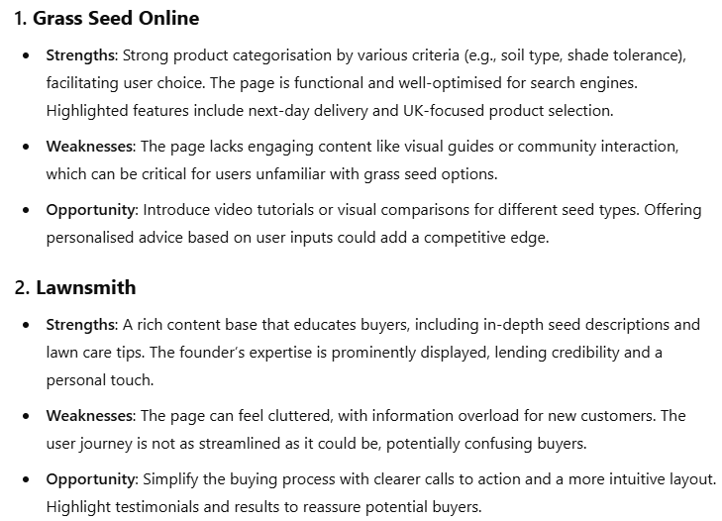
How to use ChatGPT
How to use AI effectively
The results give you and your team a starting point. Some of the feedback may not be relevant but you can tweak it as you create new prompts.

Slide 22
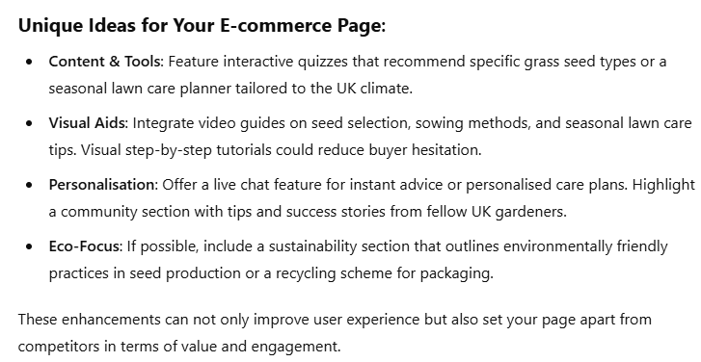
How to use ChatGPT
How to use AI effectively
This analysis is ideal as a starting point and shouldn’t be used as services or expertise.
Instead, it can point you in the right direction and potentially cut down on investigating several pages manually.
To combat issues, sense check results to make sure the recommendations seem reasonable to you.

Slide 23

Any questions?
Thank you
zak@anicca.co.uk

